Slide 1

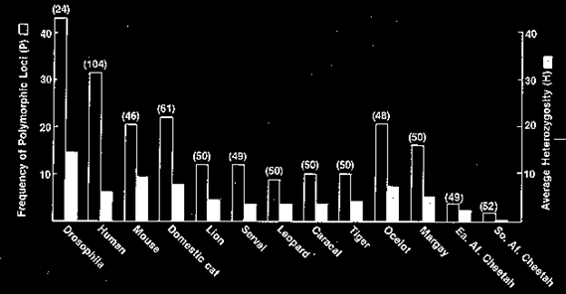
Heterozygosity is a proxy for fitness

Slide 2
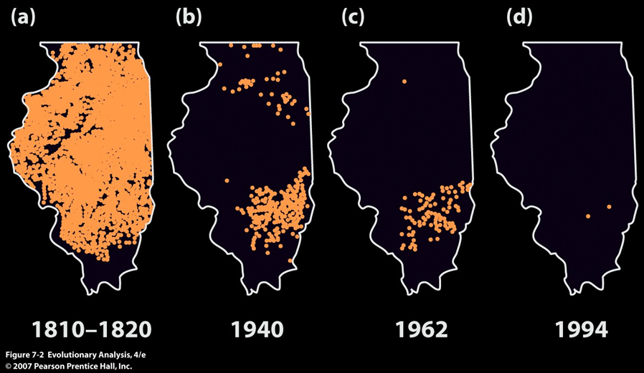
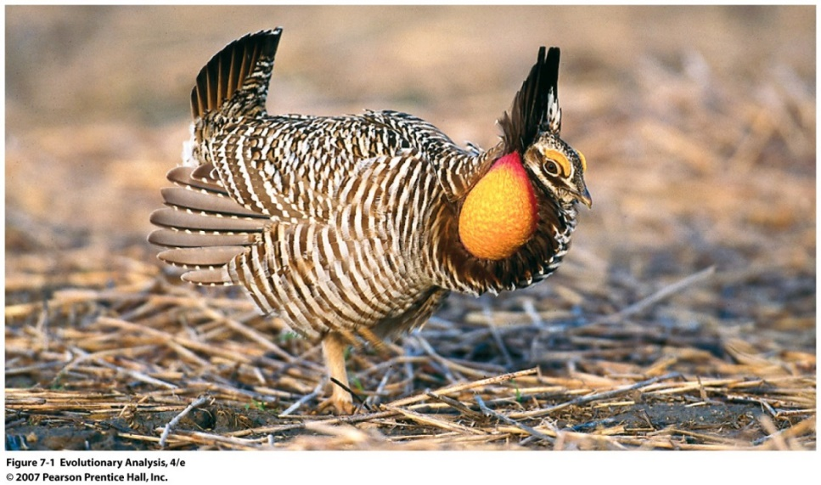
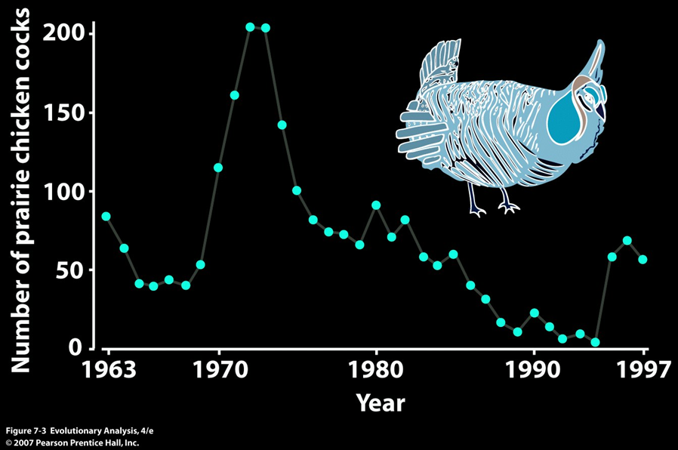
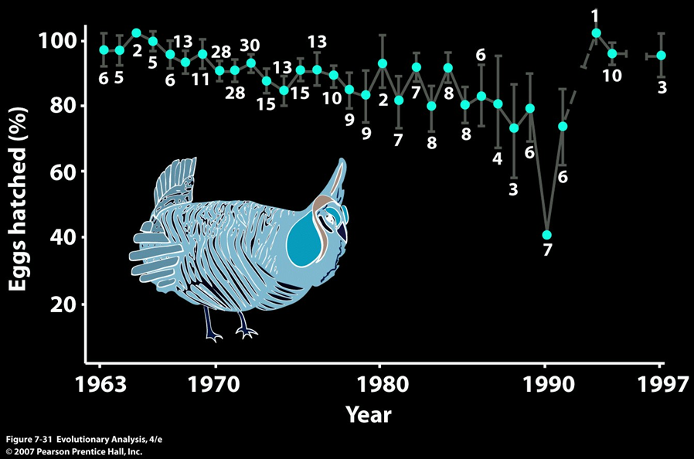
Heterozygosity is a proxy for fitness

Slide 3
But Heterozygosity is hard to measure
Heterozygosity
Genetic diversity
A
T
A
A
A
T
T
A
T
Ind 2
Ind 2
Ind 1
Ind 3
Ind 1
Ind 3

Slide 4
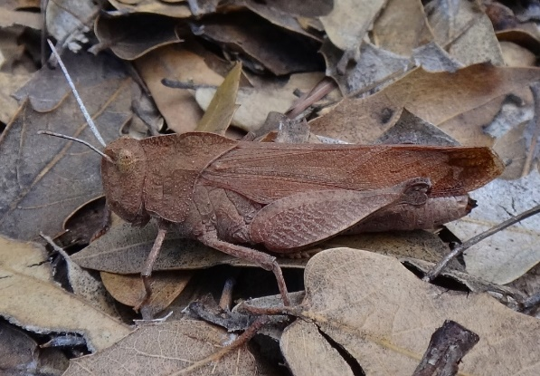

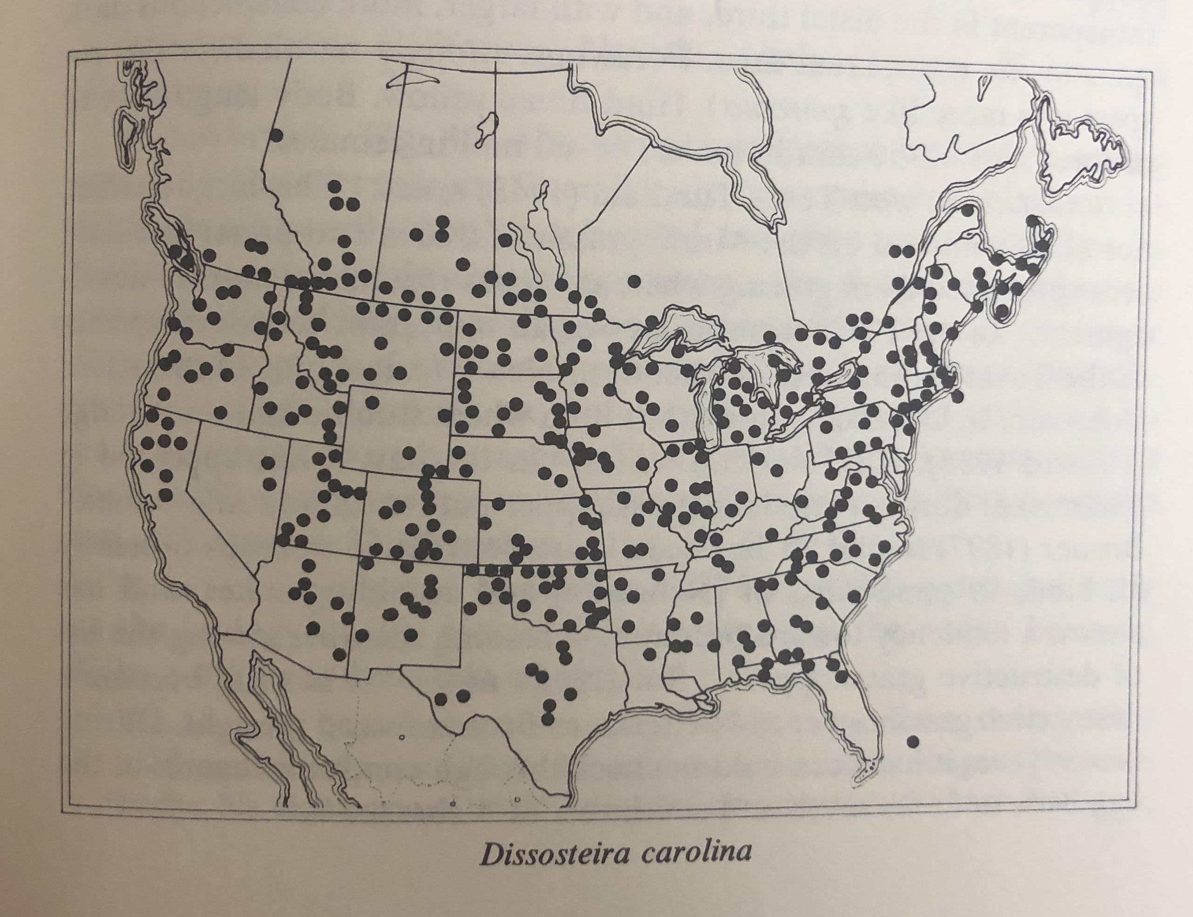
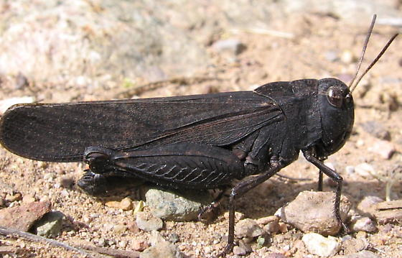
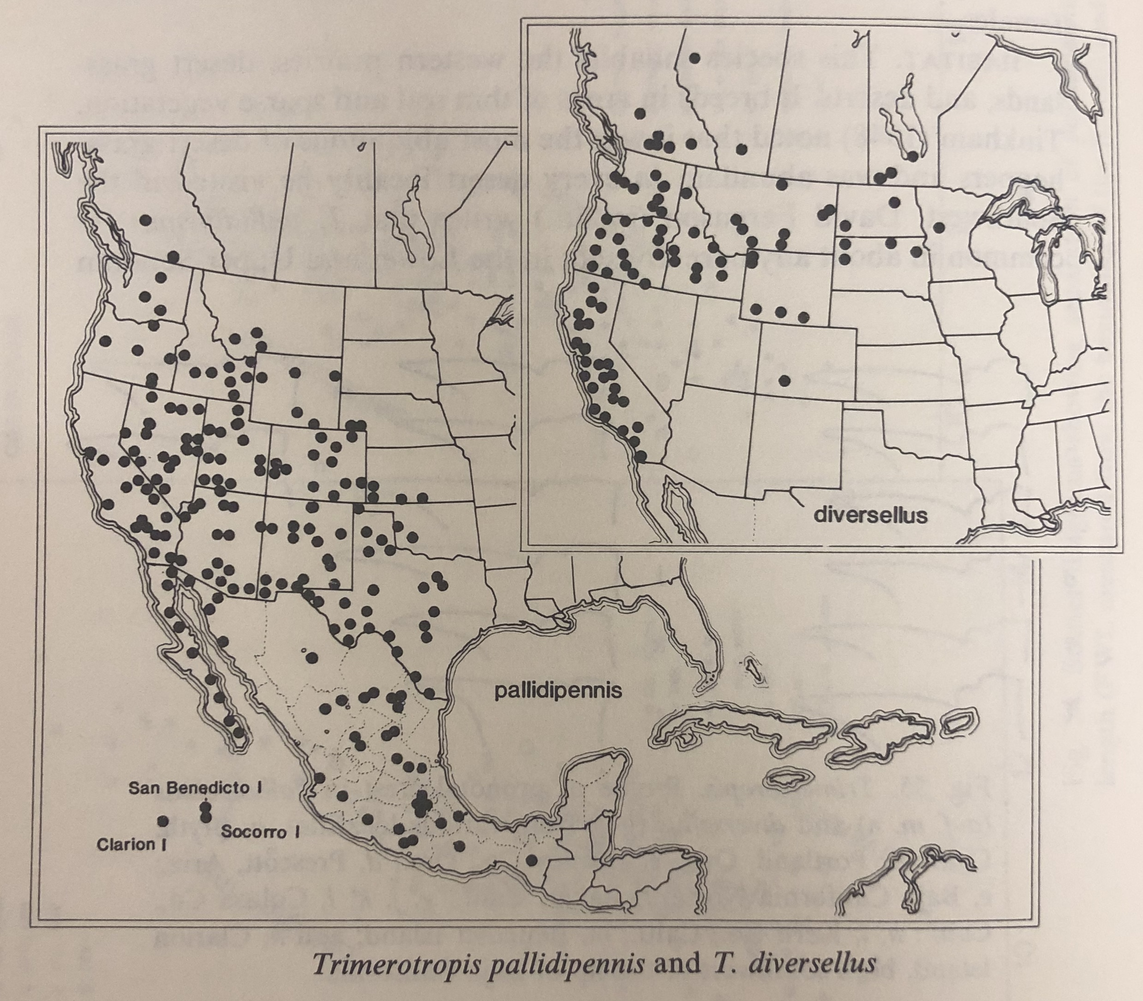
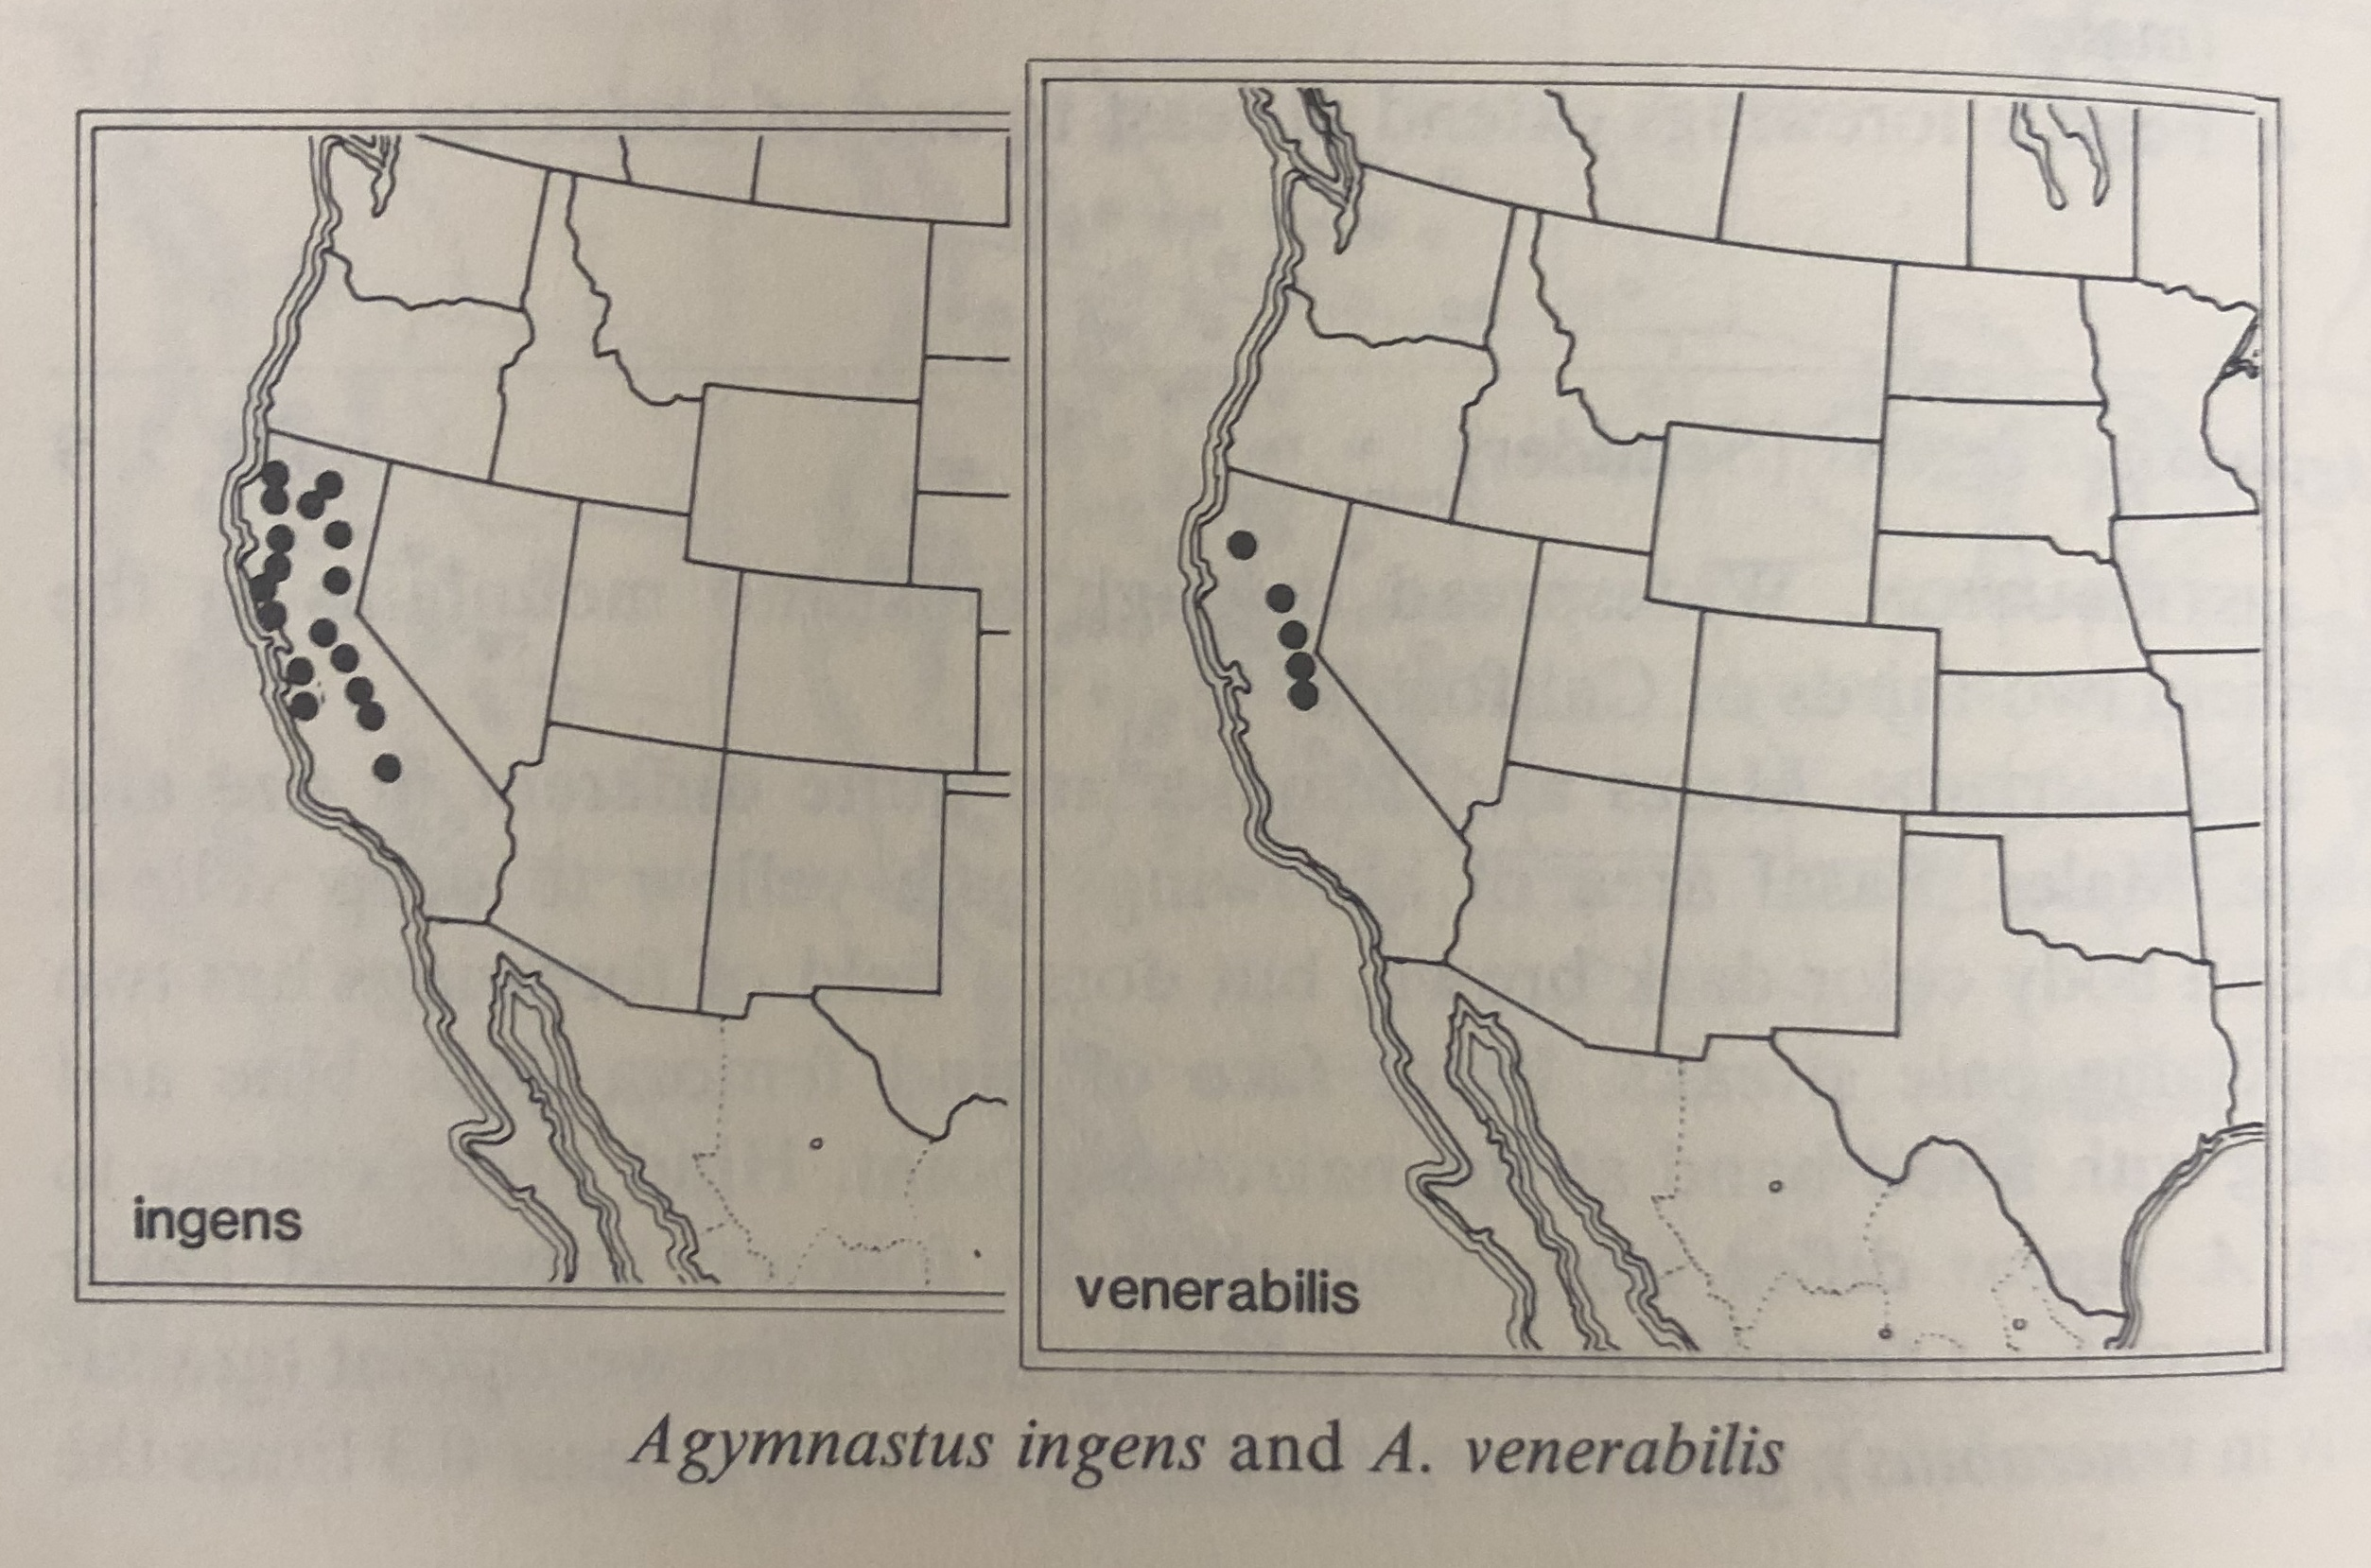
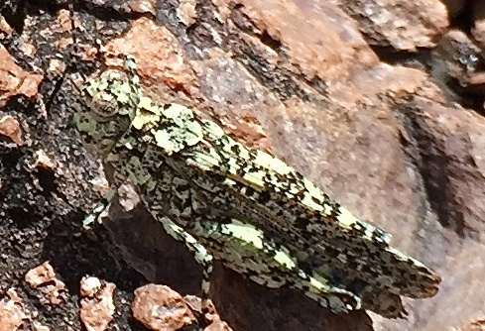
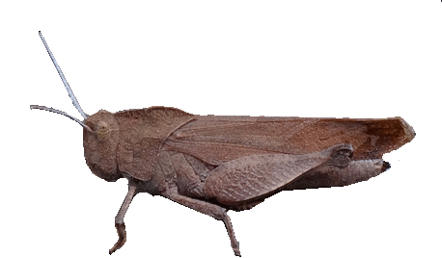
Band-winged grasshoppers (subfamily Oedipodinae)

Slide 5
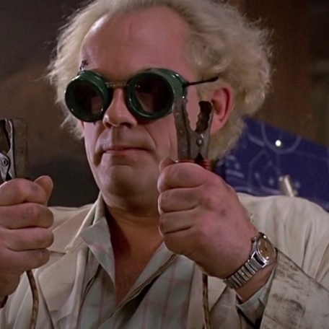
Are scientists scatterbrained?
Objective: assess whether scientists are scatterbrained
Approach:
interviewed 200 scientists from 50 universities across the US
measure :
(a) academic accomplishment (measured as number of scientific publications in high-impact journals)
(b) Scatterbrainedness severity (from least to most scatterbrained measured as follows):
1 – switched topic in the middle of a sentence
2 – got distracted in the middle of our conversation by a squirrel
3 – emailed me their latest publication but forgot to attach it
4 – wanted to show me their latest experiment but couldn’t find lab keys
5 – wanted to show me something but forgot what it was

Slide 6
Are scientists scatterbrained?
Objective: assess whether scientists are scatterbrained
Approach:
interviewed 200 scientists from 50 universities across the US
measure
(a) academic accomplishment (measured as number of scientific publications in high-impact journals)
(b) scatterbrainedness:
generate a scatterplot and calculate Pearson correlation between the two variables
Predictions: academic accomplishment is positively correlated with the level of scatterbrainedness

Slide 7
Are scientists scatterbrained?
Approach:
interviewed 200 scientists from 50 universities across the US

Slide 8
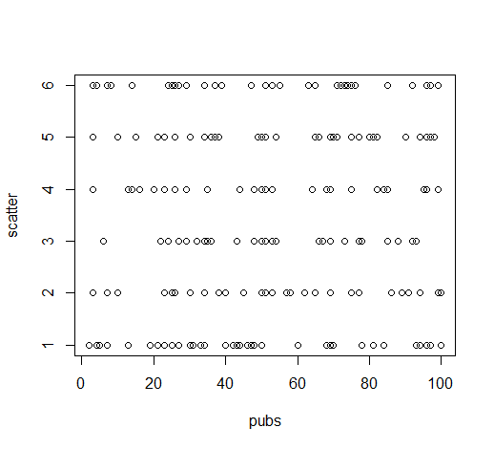
Are scientists scatterbrained?
Results:
cor = 0.06
p-value = 0.37
Conclusion: scatterbrainedness in scientists is a complete myth

